Slide 1
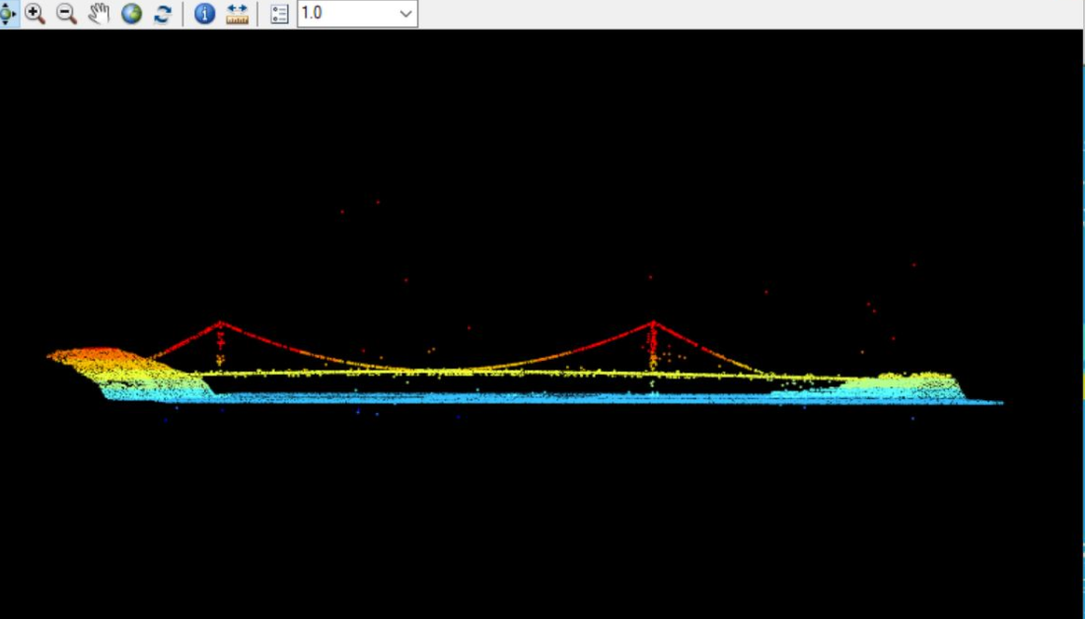
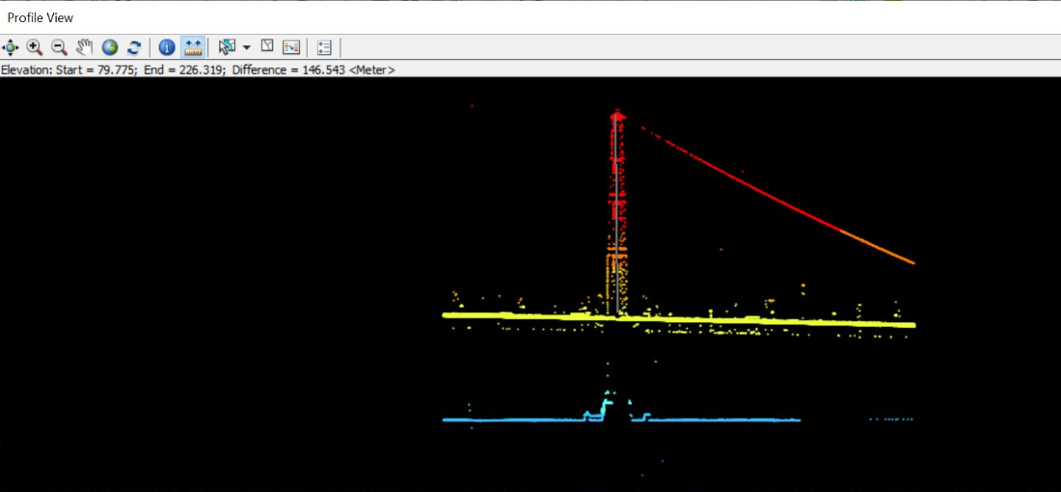
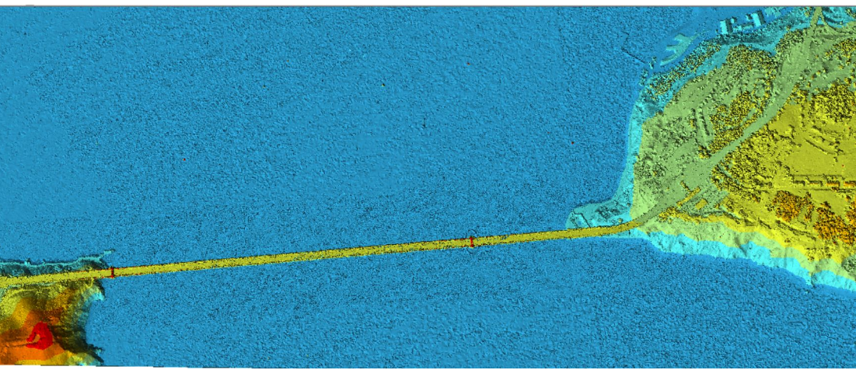
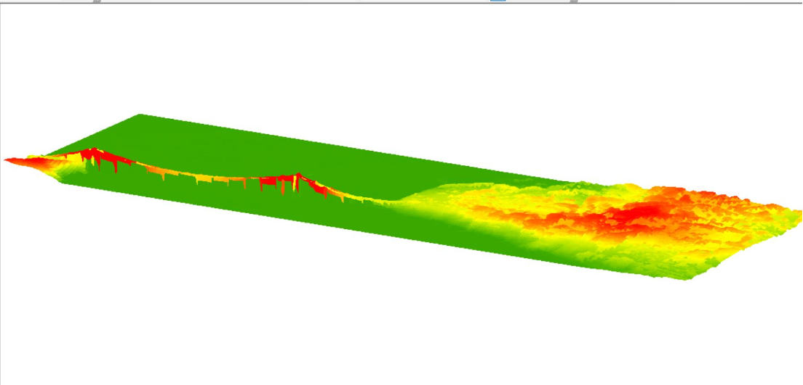
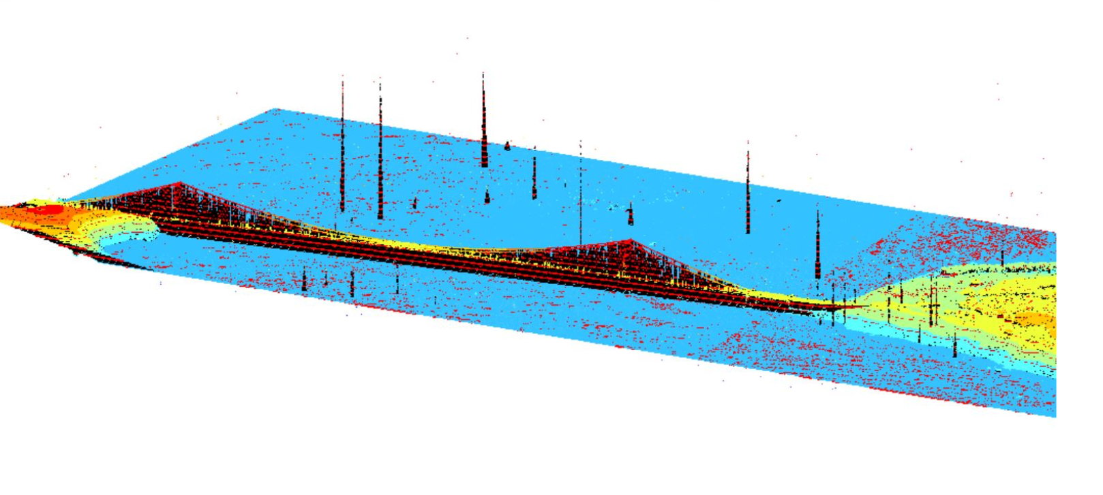
Application of basic lidar techniques to Analyze and Measure Height of Golden Gate Bridge San Francisco California
ABSTRACT
Lidar data has been used to explore detect and visualize Golden Gate Bridge in San Francisco California. Lidar data consists of millions of points. Each point has its own set of X, Y and Z coordinates and in some cases additional attributes. Remarkably, when many points are brought collected they start to show some interesting qualities of the feature that they represent. The data used in this study has LAS points: 38,692,552.
INTRODUCTION
Lidar, which stands for Light Detection and Ranging, is a remote sensing method that uses light in the form of a pulsed laser to measure ranges (variable distances) to the Earth. These light pulses—combined with other data recorded by the airborne system— generate precise, three-dimensional information about the shape of the Earth and its surface characteristics.
Because lidar is an active sensor that supplies its own light source, it can be used at night and, thus, avoid routine air traffic, or it can be flown under some types of high cloud conditions. Most lidar systems record multiple surface reflections, or “returns,” from a single laser pulse. When a laser pulse encounters vegetation, power lines, or buildings, multiple returns can be recorded. The first return will represent the elevation near the top of the object. The second and third returns may represent trunks and branches within a tree, or understory vegetation. Hopefully, the last return recorded by the sensor will be the remaining laser energy reflected off the ground surface, though at times, the tree will block all the energy from reaching the ground. These multiple returns can be used to determine the height of trees or power lines etc.Different surface models can be create using Lidar data to represent earth features in different ways. Digital surface models and Digital Elevation model are the most used models.
STUDY AREA
The Golden Gate Bridge is a suspension bridge spanning the Golden Gate, the one-mile-wide (1.6 km) strait connecting San Francisco Bay and the Pacific Ocean. The structure links the U.S. city of San Francisco, California—the northern tip of the San Francisco Peninsula—to Marin County, carrying both U.S. Route 101 and California State Route 1 across the strait. The bridge is one of the most internationally recognized symbols of San Francisco, California, and the United States. At the time of its opening in 1937, it was both the longest and the tallest suspension bridge in the world, with a main span of 4,200 feet (1,280 m) and a total height of 746 feet (227 m).
METHODOLOGY
The lidar data has been used in this project downloaded from the website of USGS. The lidar data for Golden Gate Bridge was divided into 4 different las files. All 4 files has been downloaded to get the complete view of Golden Gate Bridge. These files las files were combined to create LAS dataset. The projection used for the data was NAD_1983_UTM_Zone_10N. Using
The interactive LAS dataset toolbar offers variety of tools that will work in the ArcMap and Arc Scene. Using LAS toolbar Lidar point cloud data converted into TIN based surface. The toolbar bar provides 2D profile view and 3 D viewer functionality to visualize data as well. Using profile viewer in LAS toolbar the measurement of Golden Gate Bridge has taken. And compare the same area in a 3D viewer. The lidar data of Golden gate bride has been converted to DEM raster as well using LAS data to Raster tool in ArcMap. The lidar data and DEM data has been opened in ArcScene to see visualize in 3D environment.
Figure 1: 3D view of Golden Gate Bridge San Francisco
Figure 1: 3D view of Golden Gate Bridge San Francisco
Figure 3: Profile view of a portion Of golden Gate Bridge to measure height
Figure 2: TIN map of Golden Gate Bridge San Francisco
Figure 4: Digital Elevation Model of Golden Gate Bridge
Figure 5: 3D view of Golden Gate Bridge with contours
RESULTS AND DISCUSSIONS:
This project used lidar data that has LAS points: 38,692,552. The profile viewer in LAS dataset toolbar allowed to edit, visualize, analyze lidar data of Golden Gate Bridge using a cross sectional 2D view. In Figure 3 ,The height measured using measure tool within the profile view was 226.319 meters 741 ft.
REFERENCES
https://www.usgs.gov/media/images/3d-lidar-point-cloud-image-san-francisco-bay-and-golden-gate-bridge
https://www.usgs.gov/media/images/golden-gate-bridge-california
https://pubs.usgs.gov/ds/684/ds684_metadata/NCenCA_DEM_FGDCmetadata.html

